Slide 1
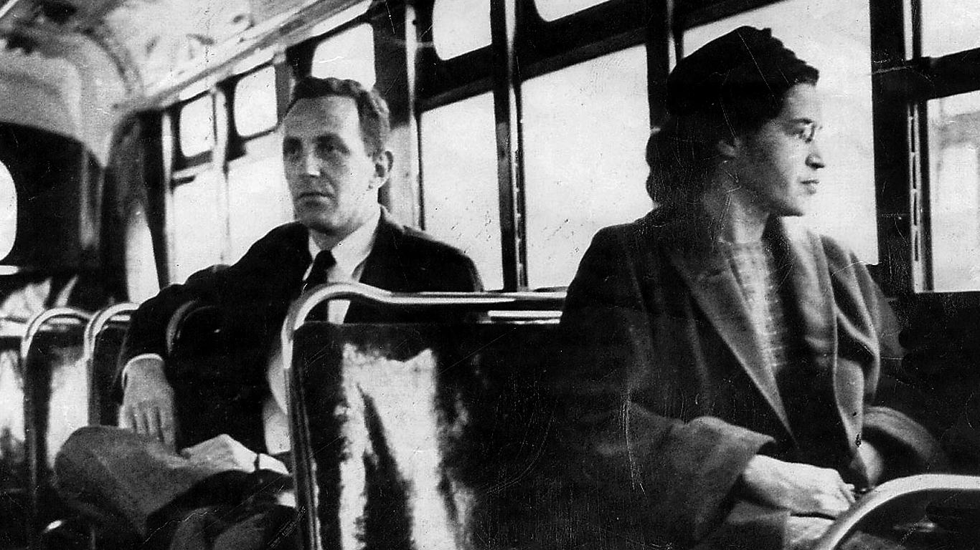
Rosa Louise McCauley Parks
Some facts

Slide 2
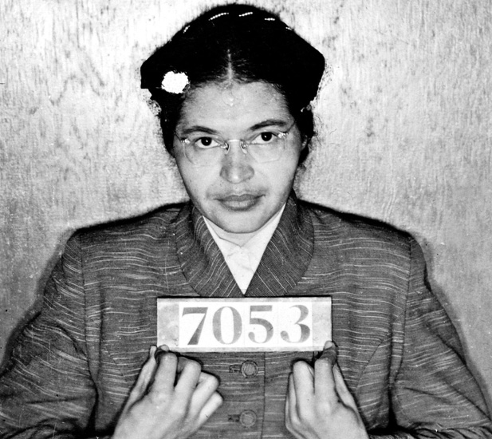
True Facts
She was Born on February 4, 1913 in Tuskegee, Alabama
she belonged to the National Association for the Advancement of Coloured People (NAACP).
Due to economic hardship, she relocated from Montgomery, Alabama to Detroit where she spent the rest of her life

Slide 3
More About Her
The case that heard Rosa Park’s act of defiance against the bus segregation laws was called Browder v. Gayle, 1956.In June of 1956, Rosa Parks won this case.
- In 1946 race riots erupted in the Southern states
.

Slide 4
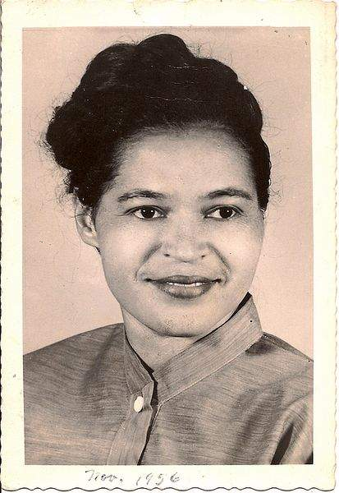
About Her
Rosa Parks sparked the civil rights movement when she refused to surrender her bus seat to a white passenger because she was tired of giving in. This was the start of nationwide efforts in ending segregation of public facilities.
Rosa Parks received recognition as one of the 20 most influential people of the 20th century by Time magazine.
In 1996, Rosa Parks was awarded the Presidential Medal of Freedom, the highest honour bestowed upon a civilian by the US government.
Rosa Parks’s grandparents were former slaves who fought for equality and freedom. She grew up in an environment and period of history when white supremacists groups such as the Ku Klux Klan abounded.

Slide 5
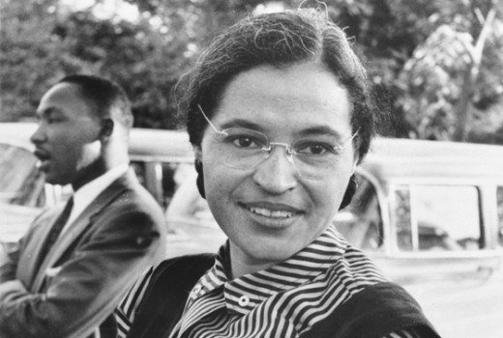
Rosa Parks worked as a seamstress and then at Virginia University
Rosa Parks received the Medal of Freedom and the the 250th Congressional Gold Medal of Honor from President Bill Clinton

Slide 6
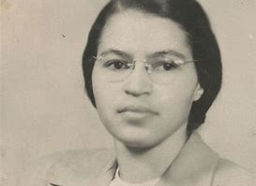
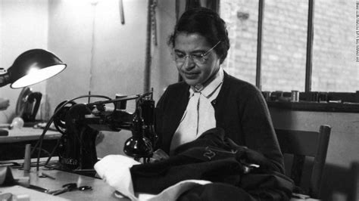
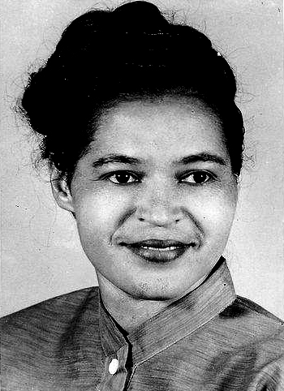
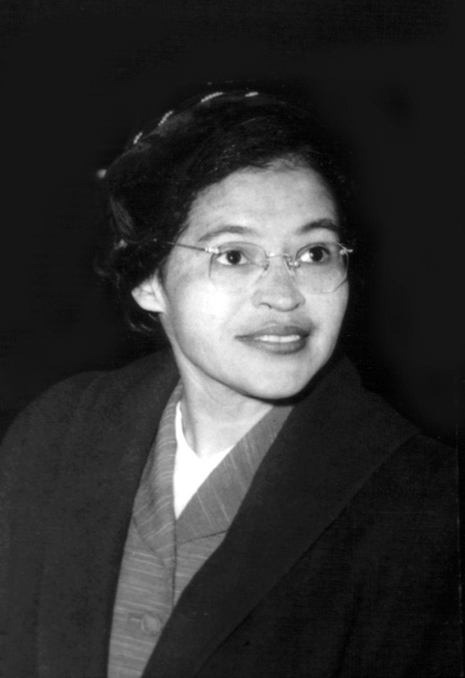
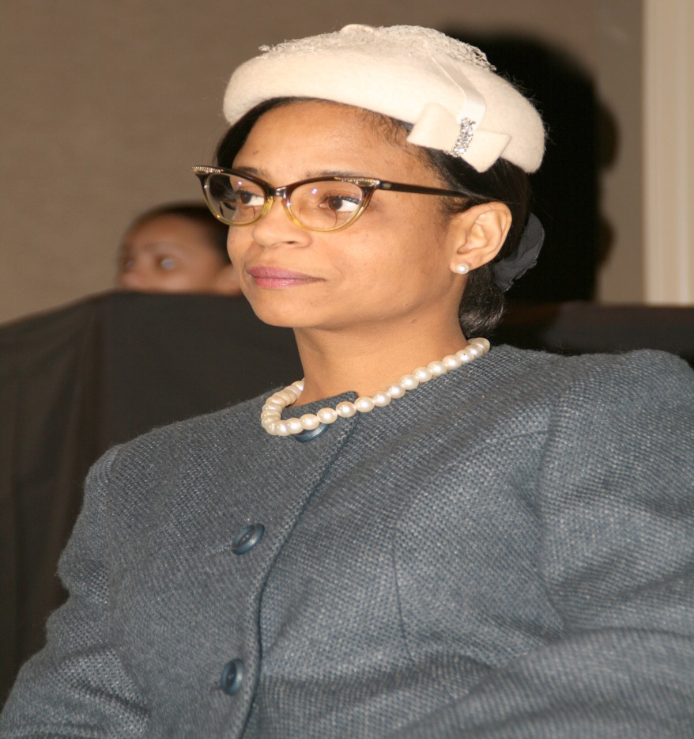

Slide 7
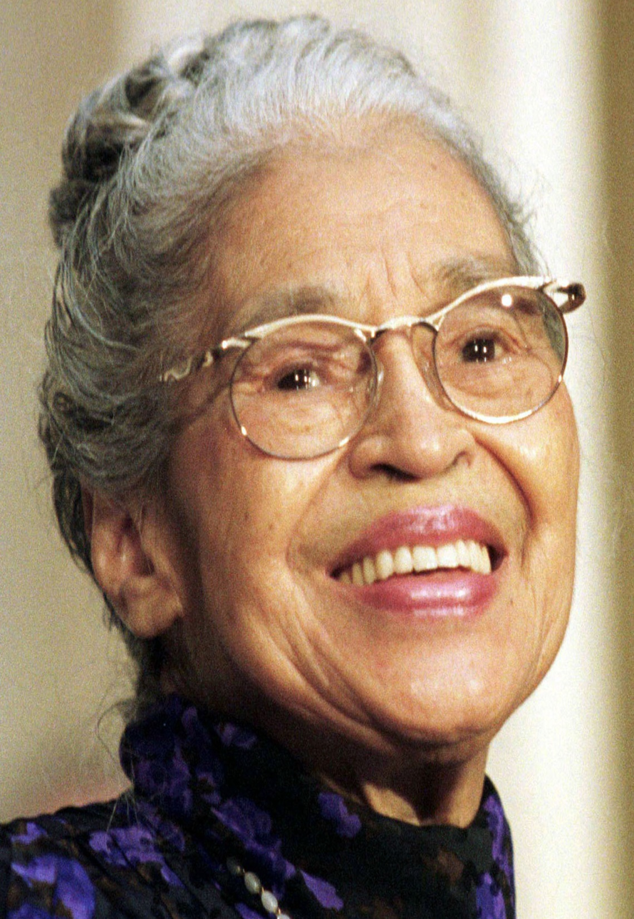
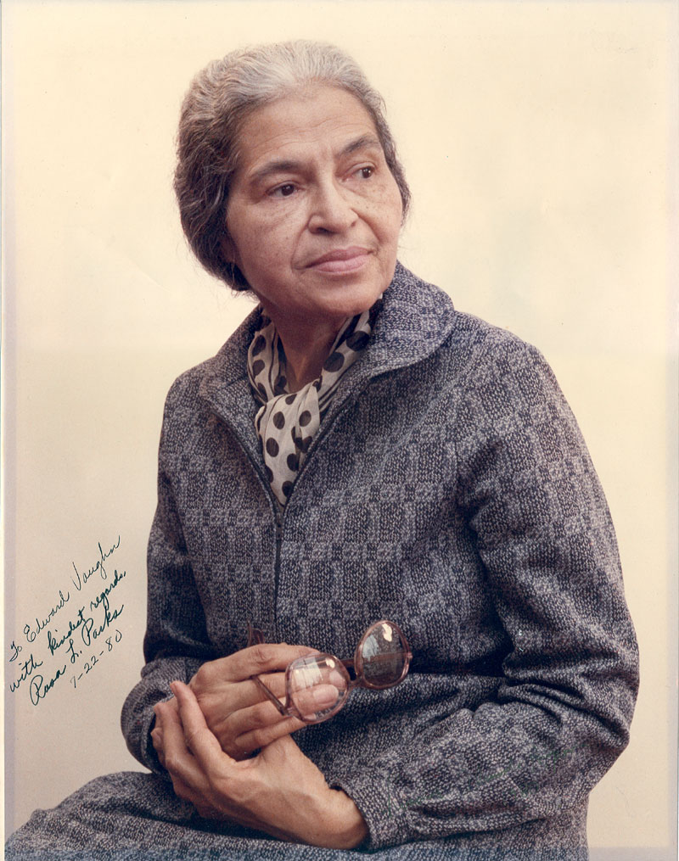

Slide 8
The End
Thankyou for watching

